Slide 1




UNIVERSITY OF PADUA
UNIVERSITA’ DEGLI STUDI DI PADOVA
Microservices Orchestration in Game Development
Orchestrate Multiplayer Game Backend with Ballerina
Marco Nardelotto
2044588
Department of Mathematics
University of Padua
Via Trieste, 63, 35121 Padua, Italy
marco.nardelotto@studenti.unipd.it
24/07/2023

Slide 2
TAKE-HOME MESSAGE

Slide 3

Take-Home
Ballerina proves to be an effective language for orchestrating microservices, either as main orchestrator, building an orchestrator completely in Ballerina, or combining it with declarative Kubernetes orchestration to maximize its potential.
PoC was mainly used to compare the use of the Ballerina language in two different types of orchestration:
Programmatic: Explicit logic through code
Declarative: Implicit logic through declaration
Applied to the specific case of managing the backend of an online video game
In the next slides, will be presented the evidence and results obtained in support of the main "take-home message".

Slide 4

Ballerina
What is Ballerina?
Ballerina is an open-source programming language for native cloud programming, that makes it easier to use, combine, and create network services.
Main features
Service composition: Combine multiple microservices
Client objects: Call remote services
Load balancing: Route traffic to different microservices
Artifact files generation: Generate Docker and Yaml configuration files
Diagrams generation: Program as sequence diagram
Type safe: Support popular file formats
Code to cloud: Deploy on Cloud

Slide 5
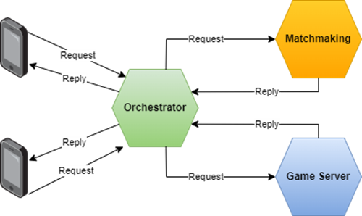
Programmatic Orchestration
Coordination logic and workflow management defined through the writing of code or scripts.
Explicit and customizable to define actions, dependencies and execution rules.
How it happens:
Writing code to define the actions, sequence and execution conditions.
Greater developer involvement in orchestration management.
Using even cloud native programming languages ​​such as Ballerina in this case.
Advantages:
Flexibility and control.
Advanced customization.
Integration.
Disadvantages:
Complexity
Higher maintenance and management costs
Less separation between business logic and orchestration logic

Slide 6
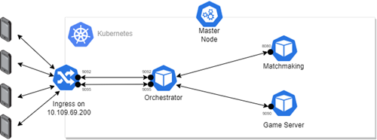
Declarative Orchestration
Coordination logic and workflow management hidden from the user.
Declarative description of desired actions, dependencies, and execution rules.
How it happens:
Orchestration Engine interprets the declarative description.
Performs actions necessary to achieve the desired state.
Manages operational details and coordination between system components.
Advantages:
Highest level of abstraction for the user.
Separation of business logic and orchestration logic.
Ease of changing execution rules without changing the source code.
Disadvantages:
Dependency on orchestration engine
Limitations of customization and flexibility
Difficulty handling errors

Slide 7


Ballerina in Programmatic
Ballerina was used to build the main orchestrator for microservices in the cloud architecture. I found advantages and disadvantages from implementation.
Advantages
Disadvantages
Specific management: service invocation, connection management, process flow.
More flexibility
Simplified creation of files for exporting Ballerina code (Docker, Kubernetes,…)
Enhanced visibility of the entire system through generated
Replicate microservices
Obtain URLs of microservices
Maintain the overall health of the system

Slide 8
Ballerina in Declarative
Ballerina was then juxtaposing to Kubernetes in a declarative orchestration environment, this made it possible to remedy some gaps in the language, introducing other disadvantages.
Advantages
Disadvantages
Replication entrusted to Kubernetes
Availability provided by Kubernetes
Better scalability
Identification of replicas (services)
Increased complexity
Create right configuration files
Dependency on Kubernetes infrastructure

Slide 9

Summary
From the analysis of the advantages and disadvantages in different situations, I feel like saying that:
If you need more flexibility in orchestration, then using Ballerina is still great for that purpose
If, on the other hand, you prefer to have a more robust environment, the best solution is orchestration with Kubernetes alongside Ballerina.
This because Kubernetes takes care of the core functionality for maintaining the system, while Ballerina can take care of the process flow.

Slide 10
Originality

Slide 11
Originality
Main originality: Comparison between programmatic and declarative orchestration, using Ballerina.
Reasons:
There is not much research on the comparison of these two modes, nor on the use of Ballerina in orchestration
The difference between the two orchestrations is almost never marked
I have not found any studies on the use of cloud native languages ​​side by side with kubernetes
It is original because it allows you to see the advantages and disadvantages that a cloud native language can bring if used in the two different types of orchestration.
In the other studies:
The theme deals mainly with programmatic orchestration
The use cases concerning the gaming sector are very few
If they were focused on the gaming sector, a cloud native language was not used for the orchestration, the implementation from 0 was shown but we started from an existing system to adapt it
Cloud native languages ​​are mostly analyzed in their characteristics and not in specific orchestration environments

Slide 12

State of Art
The research and papers analyzed that were somehow connected with the topic mainly dealt with:
Videogame development with microservices without architectural patterns
Survey on videogames and related tools
General overview of Ballerina’s features
Comparison of orchestration vs choreography
Transition from monolithic to microservices in videogames
Therefore, there are no analyzes in the use of Ballerina with Kubernetes or as a main orchestrator in a Cloud environment, only a dated example of orchestration [https://github.com/ballerina-attic/parallel-service-orchestration] which however does not exploit microservices created with other languages.

Slide 13
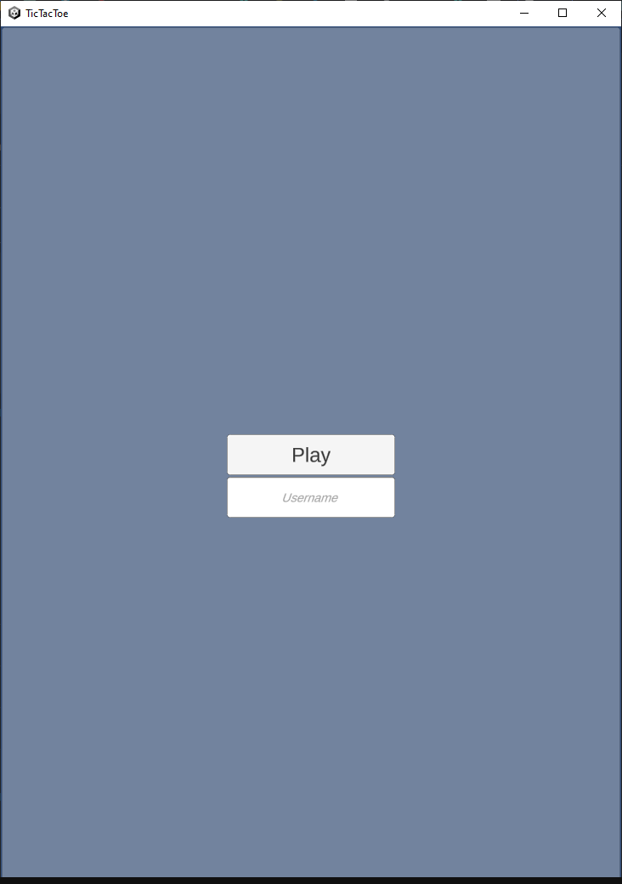
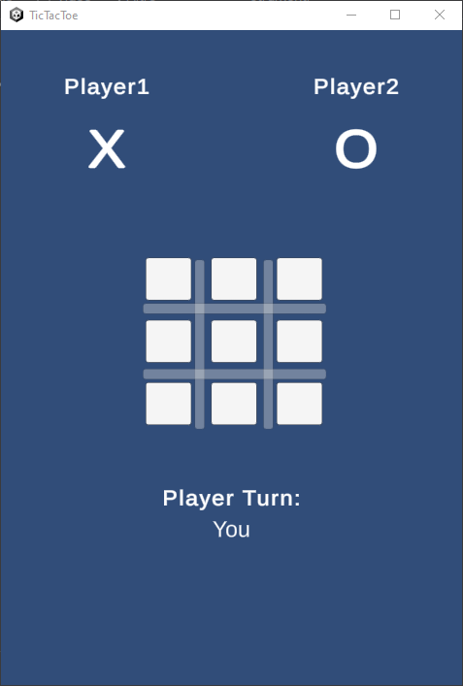
Originality 2
I tried to orchestrate several microservices, developed with various programming languages, and a video game with a game engine.
On the contrary, in other researches the video game infrastructure already exists, and attempts are made to change it to use microservices.
The inclusion of two additional microservices made overall development more challenging. It would have been more cost-effective to develop matchmaking and game server microservices using Ballerina, in order to simplify integration, deployment, and reduce overall implementation complexity.

Slide 14
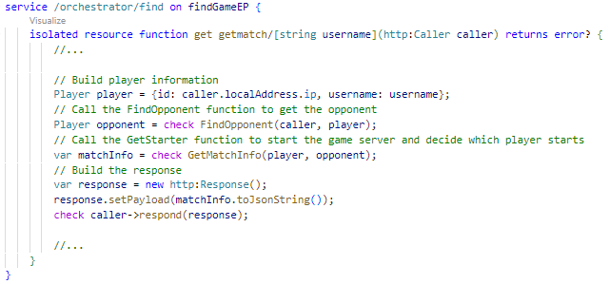
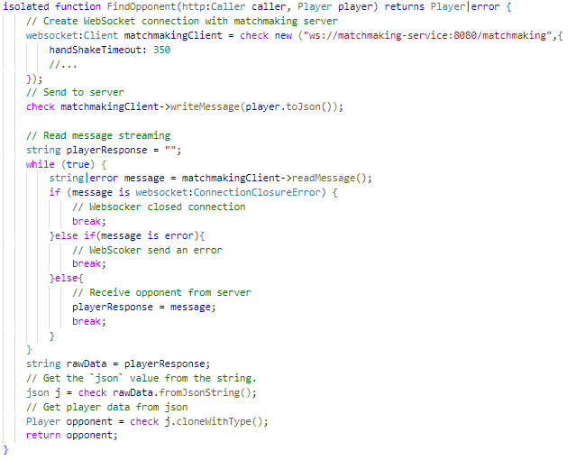
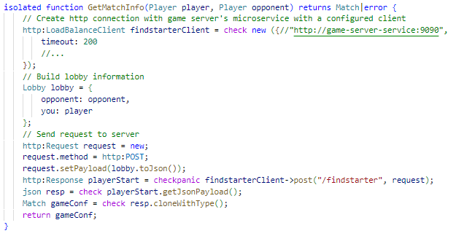
Originality 2

Slide 15
Learning Outcomes

Slide 16
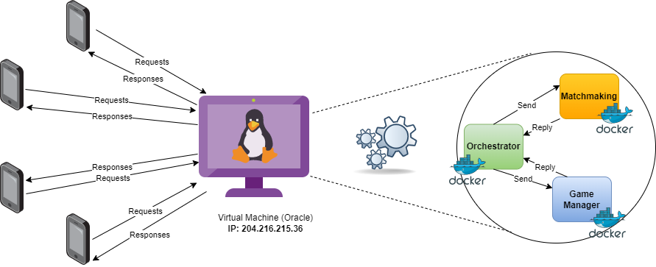
Learning Outcomes
Topics
Orchestration: Understanding of the fundamental concepts and the two main types. Exploration of implementation methods and analysis of challenging aspects, such as efficient process flow management.
Cloud
Kubernetes
In particular:
How to build a fully programmed orchestrator with Ballerina managing the process flow.
How to manage process flow in Kubernetes, which facilitated some orchestration features.

Slide 17

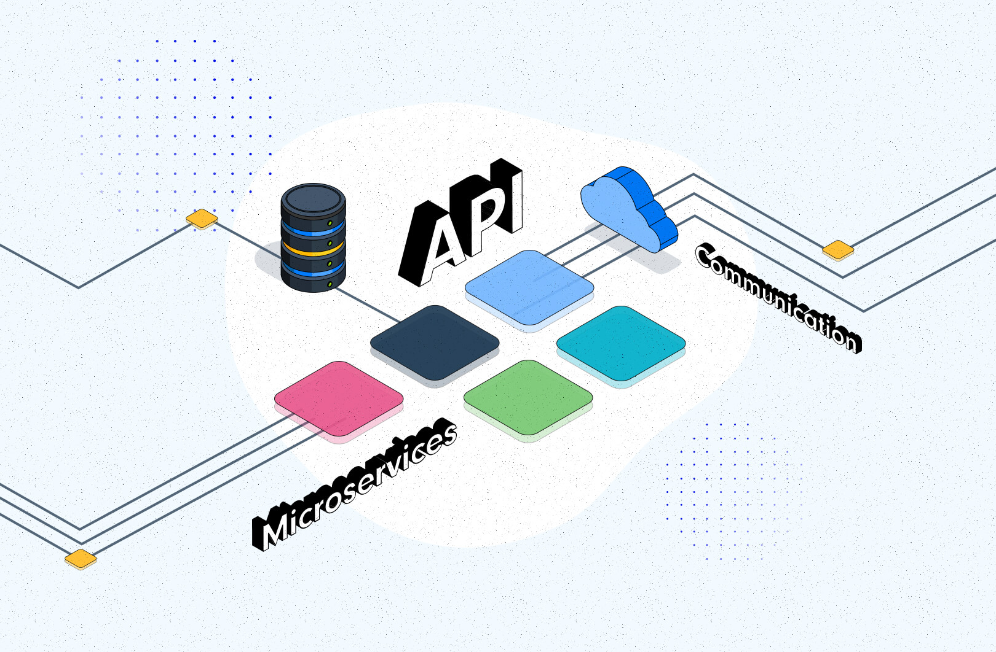
Learning Outcomes
Cloud Deployment: Deploy your system in the cloud, addressing challenges related to provider choice, system configuration, and client access to the orchestration point. This solution offers advantages such as global accessibility to the system from any device in any connected network, the use of resources provided by the provider and real-time performance monitoring.
Interfacing between different microservices: I have deepened my understanding of the mechanics of exporting ports to allow access to services and I have learned to create APIs to establish the access points of each individual microservice and the messages they can receive.

Slide 18
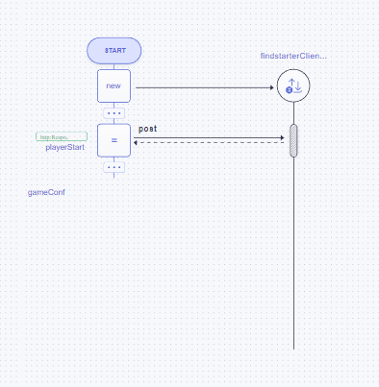
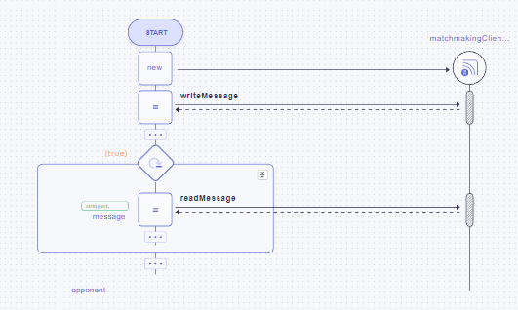
Learning Outcomes
Inter-Microservice Communication: I have a better understanding of the advantages and disadvantages of both methods. I gained a better understanding of how to connect with other microservices without depending on volatile IP addresses. I then had the opportunity to use both HTTP calls and WebSockets for communication between microservices. I also learned that HTTP calls are best suited when a single response is required in a short amount of time, while WebSockets are best suited when there are multiple message exchanges between two microservices and the connection must remain open continuously.

Slide 19

Learning Outcomes
Managing Multiple Users Simultaneously: While my tests didn't involve thousands of connected devices, I've gained a better understanding of how to efficiently manage multiple users simultaneously, especially during games.
Analysis of orchestrated systems: I have acquired skills in performing basic tests on microservices within cloud environments and in different orchestration modes. I learned some methodologies and tools useful for evaluating the performance, reliability and efficiency of orchestrated systems in a superficial way.

Slide 20
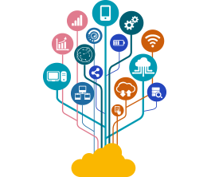
Learning Outcomes
Technologies
Ballerina:
Main features
Programming approach with a cloud-oriented vision
Using Docker to create containers for microservices
Using Dockerfile and Docker Compose
Communication between microservices within the Docker environment
Using Docker Hub for microservices image availability
Docker:
Concepts of declarative orchestration
Replication and linking of services within the cluster
Using YAML files for configuring components
Identification of access points to services and primary access point outside the cluster
Benefits of replicating microservices in the event of failure
Kubernetes:
Oracle Cloud VM:
Using Oracle Cloud VM to distribute the system in the cloud
Features like free VM plan, multiple port exposure and static IP
Goland e Visual Studio:
Tools used for microservices development

Slide 21
Imbalance

Slide 22

Imbalance
Opinion: Course requires more than 6 credits
Reasons:
The project took longer than necessary
For course topics, the load was just right
The ideal would be a course with more credits to better understand some topics
The course could be 7-8 credits due to the additional workload of carrying out the project.

Slide 23
Criticisms/Suggestions

Slide 24

Criticisms
Criticality: In particular none I report that I was unable to access the resource: https://doi.org/10.1007/978-3-319-92432-8_10
Some considerations: The course went well obviously the first part was much more in-depth than the second and perhaps it's a shame, I understand understanding the basics well but then it seems to me that everything was done a little faster.
Suggestions:
Deal more with the cloud argument
Flipped classroom on Cloud-Native languages
Flipped classroom on further collaborative challenge
Provide even more “practical” resources that are more useful for projects

Slide 25
Thanks For The Attention

